Slide 1
Objective: Plot LD decay for 3 sub-populations (processing, fresh market and vintage) with two trendline; locally weighted scatterplot smoothing (LOESS) and non-linear regression (NLR)
Sim et al. (2012) calculated LD in Tassel and created the graph the in R. I used the R package ‘LDheatmap’ to calculate LD
Used a smoothing parameter of 0.3 for LOESS
The “model of Hill and Weir” was used to calculated NLR

Slide 2
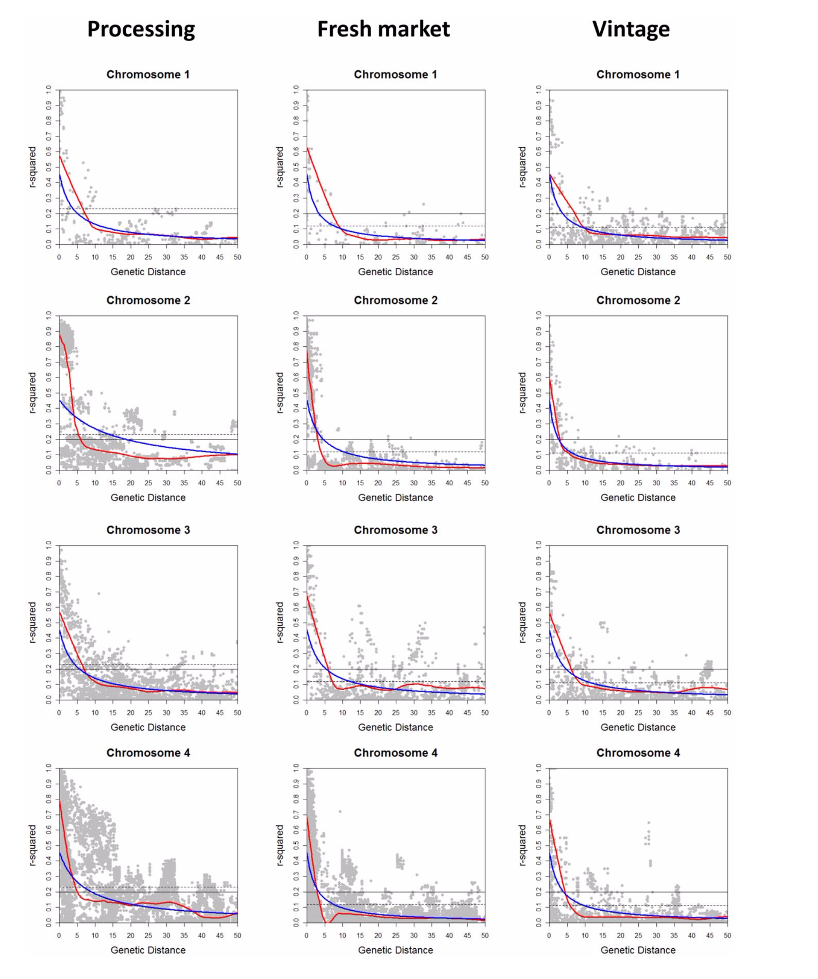
Sim et al. 2012

Slide 3
Sim et al. 2012

Slide 4
Sim et al. 2012

Slide 5
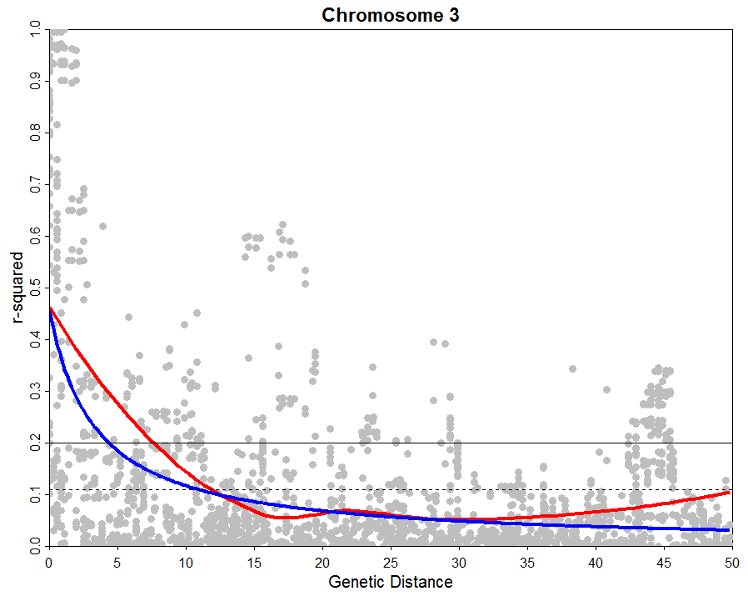
Vintage
Sim et al. 2012

Slide 6
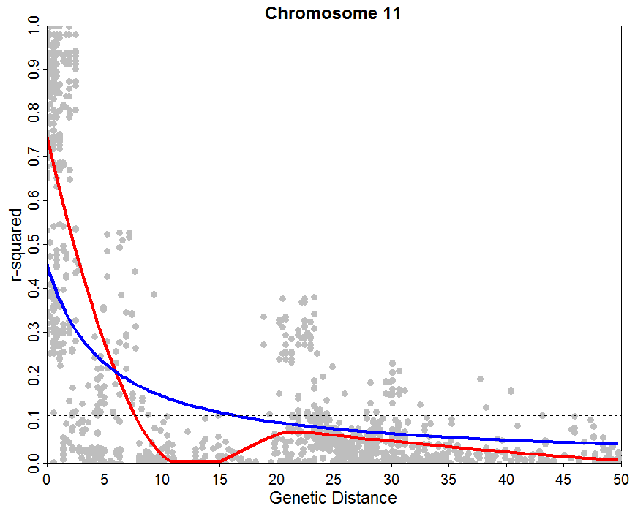
Vintage
Sim et al. 2012

